Slide 1
Transition Algorithms to Python
Algo-Meeting January 23

Slide 2
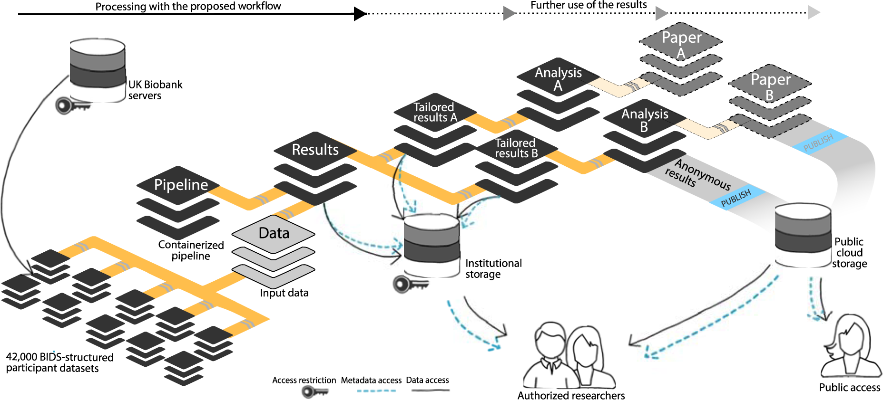
Idea

Slide 3

NeuroGeriatricMotionToolbox (NGMT)
Python based
Import functions for every used systems (easy adaptation for future systems)
Structure by:
Type of test (Walking, Balance, Hybrid)
Type of enviroment (Supervised, @home)
Task (TuG, SPPB)
Output:
Walking parameters (e.g step time) & markers (IC, FC)
Balance parameters

Slide 4
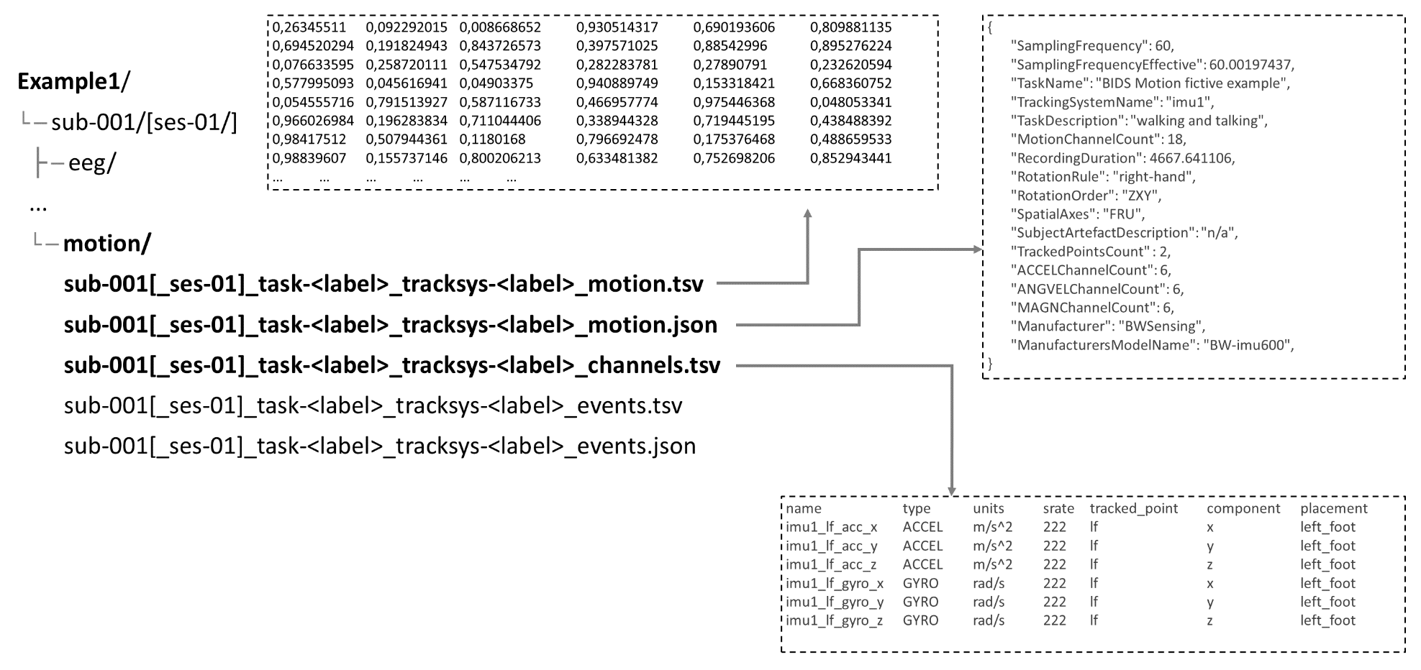
Toolbox structure
NGMT
Raw data & meta-data concept (BIDS)
IMU data
Optical data
(non) gait events
[task]_walking_params.csv
Hasomed
RehaGait
 | Step time | DLST | …
ID01
ID02
ID03
ID04
Qualisys
Walking
Balance
Hybrid
Supervised
Semi-supervised
Not supervised
TuG
20m straight
Circular walk
Functional reach
6mWT

